Slide 1

Spring Boot Part 2

Slide 2
Agenda
Homework 1 answer
Maven Introduction
Setting Oracle in Spring boot
Database Connection Pool
Database Statement and Transaction
Build Java Project to War File

Slide 3
Maven Introduction
Maven is a Java tool, so you must have Java installed in order to proceed.
Maven is tool with multiple facets :
A BUILD tool
A DEPENDENCY MANAGEMENT tool
A DOCUMENTATION Tool
Before Maven, it was really hard to find java libraries, and harder to ensure a coherent use of these libraries

Slide 4
POM file
Maven most important unit is POM file
A Project Object Model or POM is the fundamental unit of work in Maven. It is an XML file that contains information about the project and configuration details used by Maven to build the project

Slide 5
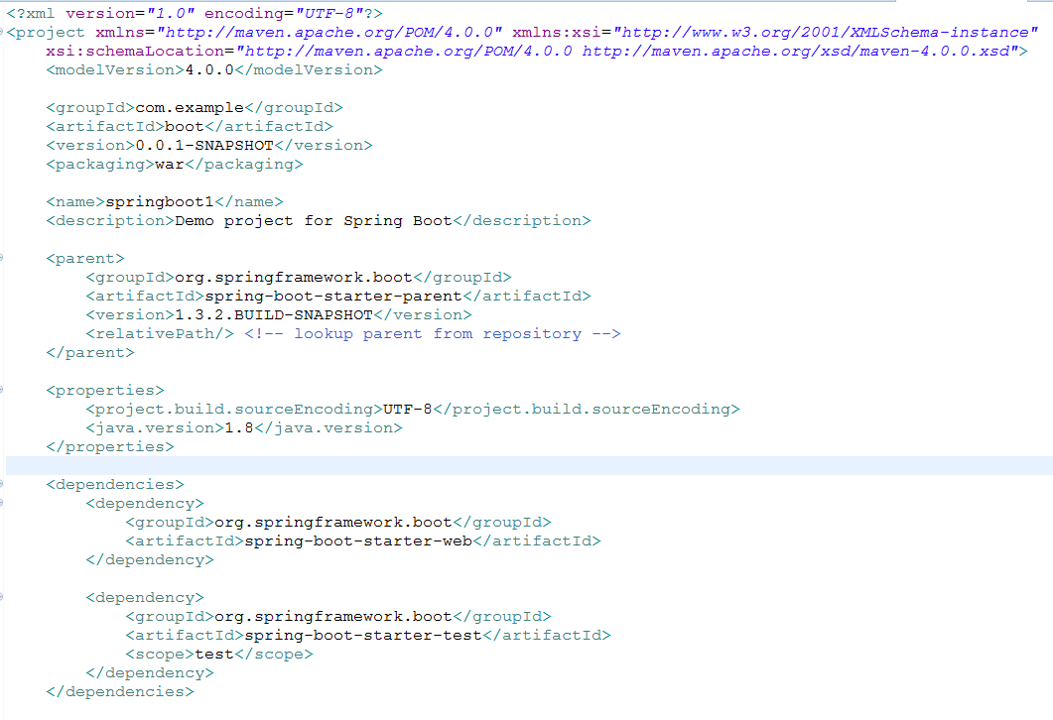
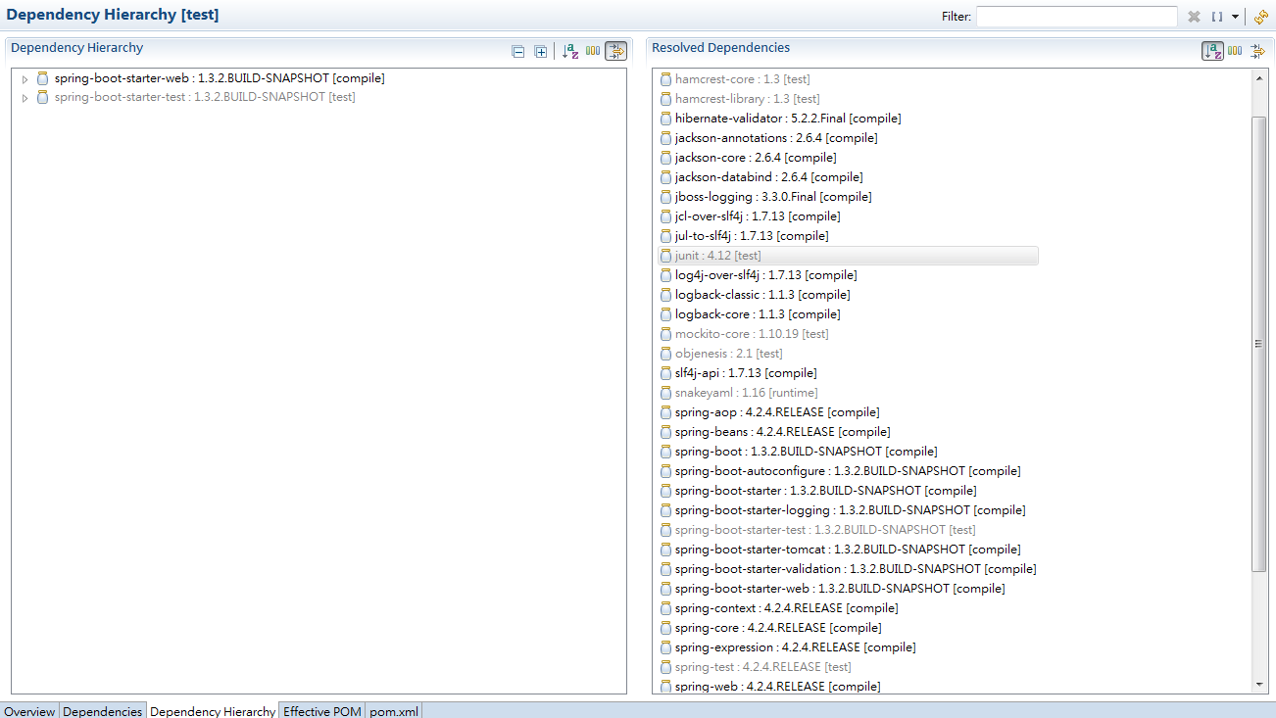
POM File Example
Building war: D:\workspace_eclipase\springboot1\target\boot-0.0.1-SNAPSHOT.war

Slide 6
Maven Repositories
Maven Repositories used to placed downloaded jar file
By default in user home’s .m2/repository folder
Can be moved to another place through Maven runtime setting.xml file
($MAVEN_HOME/conf/setting.xml)

Slide 7
Maven Build Lifecycle
Phase
compile
test
package
install
deploy
Life Cycle

Slide 8
How Maven Build works
When you invoke a phase, Maven will go through all the phases until the one specified, executing the bound goals:
Mvn package
compile
compiler:compile
test
surefire:test
package
jar:jar

Slide 9
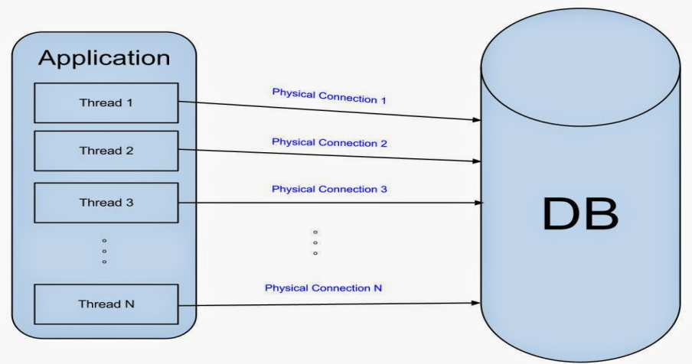
Database Connection Pool
Application Without Connection Pool
Application without connection pool downside :
When a lot of thread try to make connection to database , it will eat up ddatabase resource
There is no connection object reuse with this schema
Can’t control the amount of connection which try to connect to database
Big effort required to manually manage connection objects

Slide 10
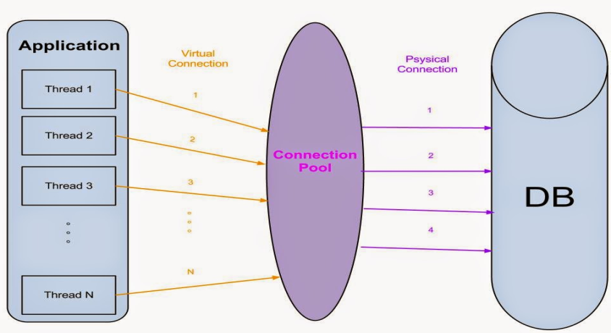
Database Connection Pool
Application With Connection Pool
Connection pools provide the following benefits:
Reduces the number of times new connection objects are created , promotes connection object reuse.
Controls the amount of resources spent on maintaining connections.
Reduces the amount of effort required to manually manage connection objects.
Provide help for connection state or close connection
Defaults setting of apache commons dbcp
https://commons.apache.org/proper/commons-dbcp/configuration.html

Slide 11
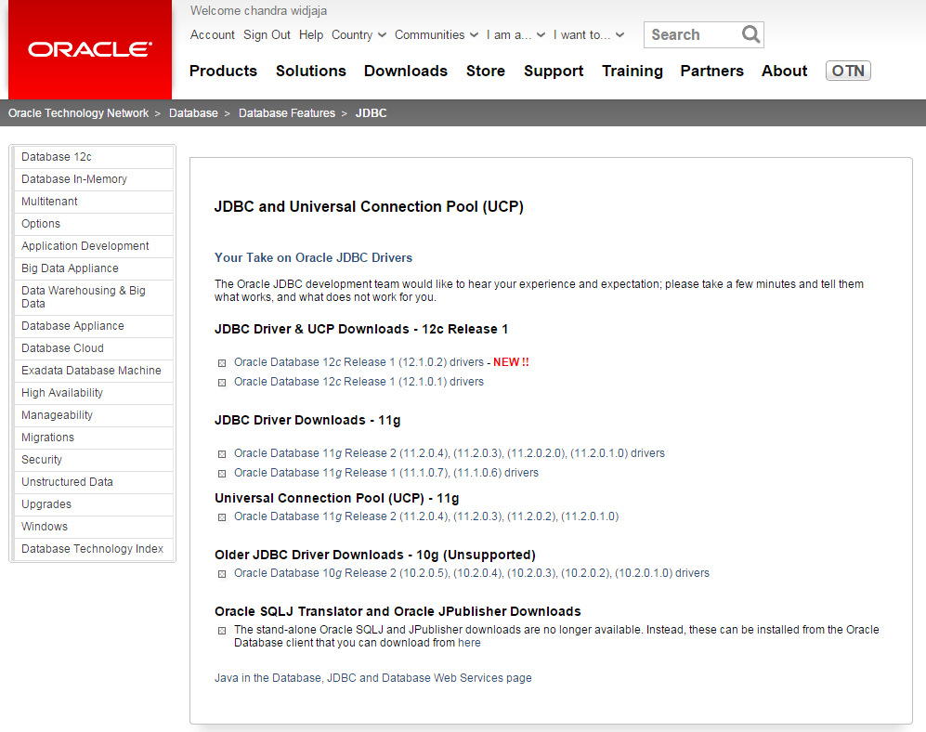
CONFIGURING SPRING BOOT FOR ORACLE
Oracle Database Driver
The Oracle JDBC drivers are not in public Maven repositories due to legal restrictions.
you will need to download the JDBC driver from Oracle Web Site. And then you can install it into your local Maven repository manually.
http://www.oracle.com/technetwork/database/features/jdbc/index-091264.html

Slide 12
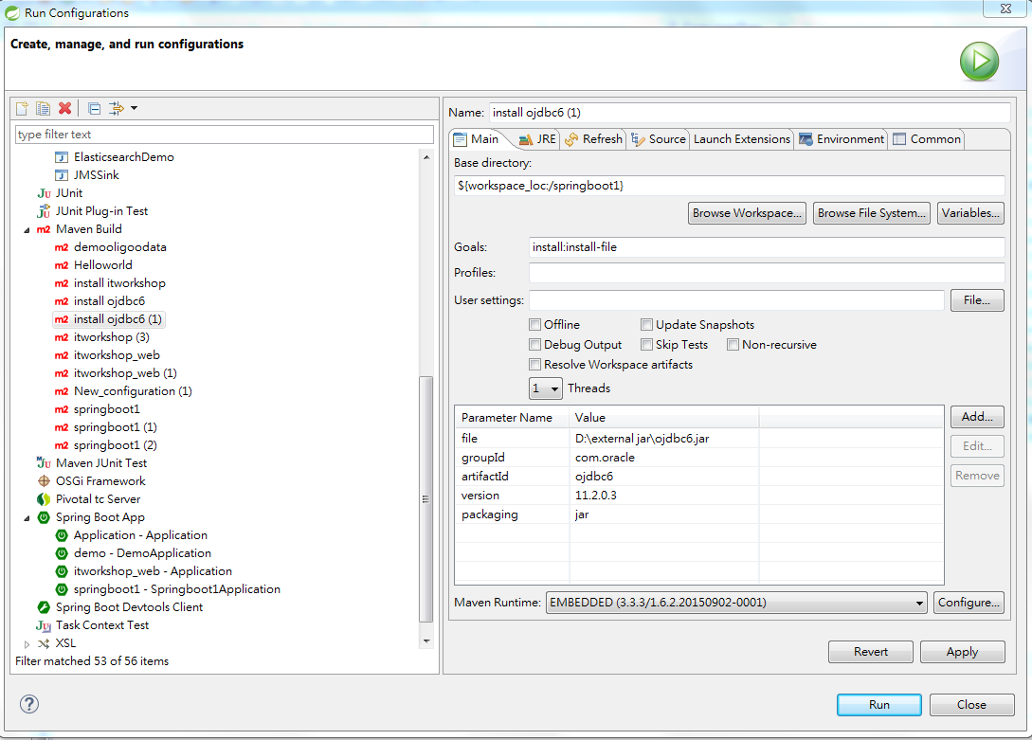
Installing Oracle Jar into Maven
You can install a JAR into your Maven repository using this Maven command. You may need to adjust the version and name depending on the JDBC driver version you download.
mvn install:install-file -Dfile=(filename.jar) -DgroupId=(file groupId) -DartifactId=(file artifactId) -Dversion=(file version) -Dpackaging=jar
OR
You can use Eclipse to import Oracle driver to Maven
Right click and select Run As
Select Run Configuration
Write down the information for maven to run like this picture then click run

Slide 13
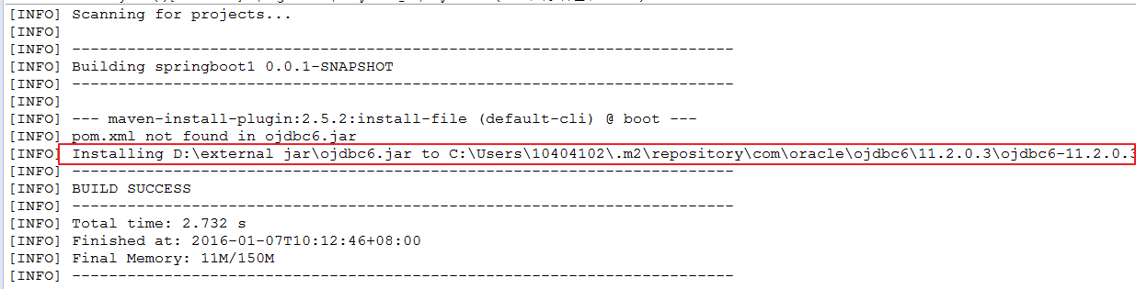
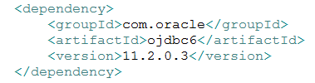
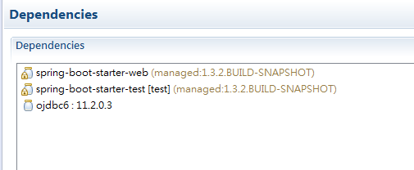
Run Result will be like this
After Add Oracle Driver to Maven Repository , we need to add dependency setting on POM file
Finished and Oracle driver will be add to dependencies

Slide 14
JDBC - Statements
The JDBC Statement, CallableStatement, and PreparedStatement interfaces define the methods and properties that enable you to send SQL or PL/SQL commands and receive data from your
Interfaces | Recommended Use
Statement | Use the for general-purpose access to your database. Useful when you are using static SQL statements at runtime. The Statement interface cannot accept parameters.
PreparedStatement | Used when you plan to use the SQL statements many times. The PreparedStatement interface accepts input parameters at runtime.
CallableStatement | Used when you want to access the database stored procedures. The CallableStatement interface can also accept runtime input parameters.
Closing Statement Object
Don’t forget to close the Statement Obejct to save database resources

Slide 15
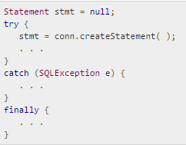
Continue
Creating Statement Object
Example
Three execute methods :
boolean execute (String SQL): Returns a boolean value of true if a ResultSet object can be retrieved; otherwise, it returns false
int executeUpdate (String SQL): Returns the number of rows affected by the execution of the SQL statement
for an INSERT, UPDATE, or DELETE statement.
ResultSet executeQuery (String SQL): Returns a ResultSet object. Use this method when you expect to get a result set, as you would with a SELECT statement.

Slide 16
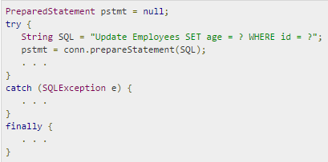
Continue
PreparedStatement Objects
Example
All parameters in JDBC are represented by the ? symbol, which is known as the parameter marker.
The setXXX() methods bind values to the parameters, where XXX represents the Java data type of the value you wish to bind to the input parameter
Example : ps.setString(1,”TestAbc” ); ps.setInt(2,123);
The first marker represents position 1, the next position 2, and so forth. This method differs from that of Java array indices, which starts at 0.

Slide 17
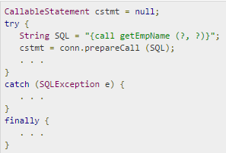
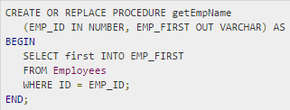
Continue
The CallableStatement Objects
Example
Stored Procedure Example
Use connectionInstance.prepareCall(storedprocedure) to set the CallableStatement
IN parameters → use the setXXX() method that corresponds to the Java data type you are binding.
OUT and INOUT → use registerOutParameter(). The registerOutParameter() method binds the JDBC data type, to the data type that the stored procedure is expected to return.
Retrieve the value from the OUT parameter with the appropriate getXXX() method.

Slide 18
JDBC - Transactions
AutoCommit
JDBC Connection is in auto-commit mode (by default) , then every SQL statement is committed to the database upon its completion.
To enable manual- transaction support instead of the auto-commit then use the Connection object's setAutoCommit() method.
setAutoCommit(false) → turn off auto-commit
setAutoCommit(true) → turn on auto-commit
Commit & Rollback
Once you are done with your changes and you want to commit the changes then call commit() method on connection object
conn.commit( );
to roll back updates to the database made using the Connection named conn.
conn.rollback( );

Slide 19
JDBC – Save Points
Using Savepoints
The new JDBC 3.0 Savepoint interface gives you the additional transactional control.
You can use the rollback method to undo either all the changes or only the changes made after the savepoint.
The Connection object has two new methods that help you manage savepoints
setSavepoint(String savepointName): Defines a new savepoint. It also returns a Savepoint object.
releaseSavepoint(Savepoint savepointName): Deletes a savepoint. Notice that it requires a Savepoint object as a parameter.
Use rollback (String savepointName) method, to rolls back work to the specified savepoint.
//set a Savepoint
Savepoint savepoint1 = conn.setSavepoint("Savepoint1");
//rollback with savepoint
conn.rollback(savepoint1);

Slide 20
JDBC - Batch Processing
Batch Processing allows you to group related SQL statements into a batch and submit them with one call to the database.
Methods of Batch Processing :
The addBatch() method of Statement, PreparedStatement, andCallableStatement is used to add individual statements to the batch.
The executeBatch() is used to start the execution of all the statements grouped together. Returns an array of integers, and each element of the array represents the update count for the respective update statement.
The clearBatch() method → This method removes all the statements you added with the addBatch() method. However, you cannot selectively choose which statement to remove.

Slide 21
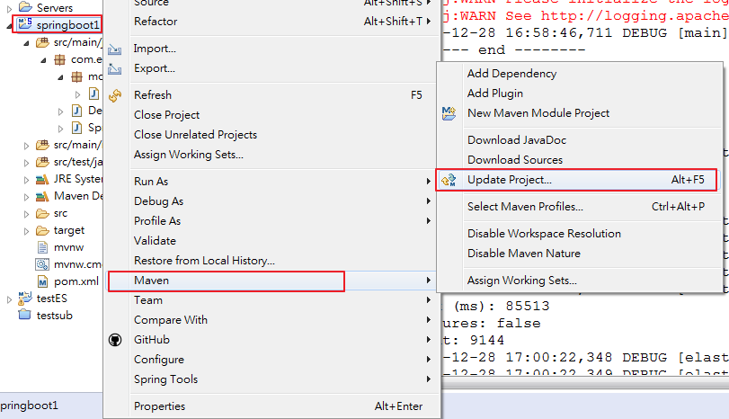
Build Project Into Executable Jar
Maven Update Project first

Slide 22
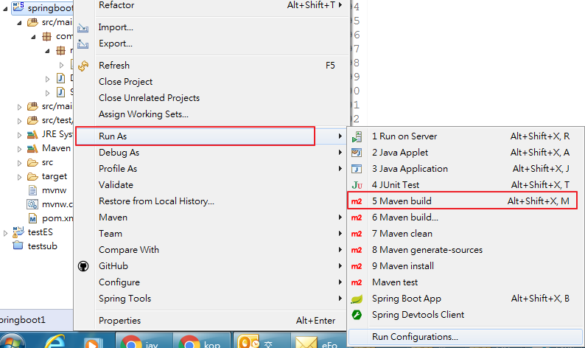
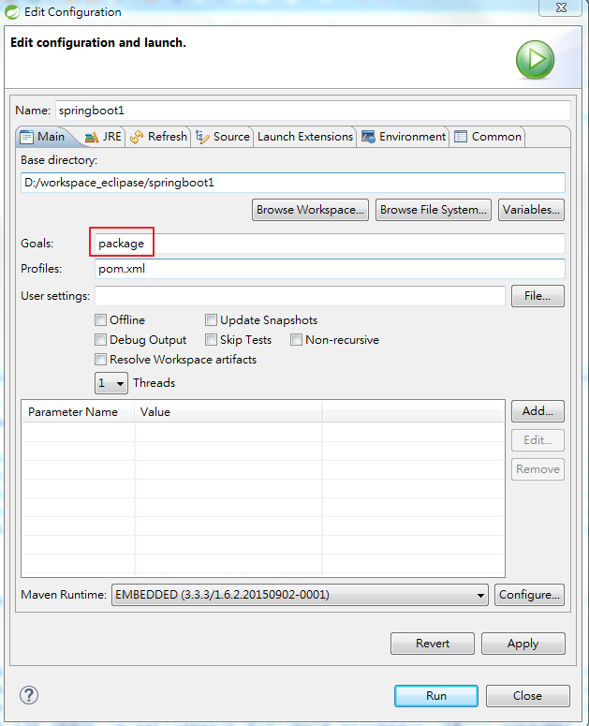
2. Run as Configuration

Slide 23
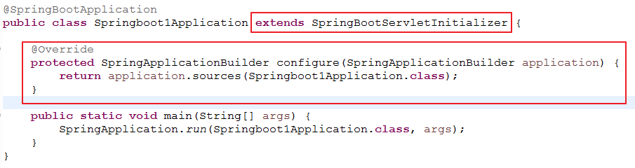
Build Project Into War File
modify pom.xml to change the packaging to war
The final step in the process is to ensure that the embedded servlet container doesn’t interfere with the servlet container to which the war file will be deployed.
Notes:
https://docs.spring.io/spring-boot/docs/current/reference/html/howto-traditional-deployment.html

Slide 24
Homework
Use Database Connection Pool (apache commons) to Connect Oracle DB
➔ set total max connection = 5
Create PrepareStatement with commit and rollback and savepoints(insert to DB) (post method)
➔ with error exception so can use rollback and savepoints
Create Statement for query data from database and return model(pojo) to client(post method)
Create CallableStatement to execute stored procedure(post method) → use 10404102 for id
Create Batch processing transaction return delta time between start time and end time.(use 500 records)

Slide 25


Thank You !

